Slide 1
Business Strategy, Quality Improvement and Innovation—a State and AAA Perspective Business Development: Strategies to Strengthen Systems and Staff Skills
Abigail Morgan, VP-Planning & QI
Matthew l. Reed, Senior Vice President

Slide 2
introductions
Direction Home Akron Canton Area Agency on Aging and Disabilities
Matthew L. Reed
Abigail M. Morgan

Slide 3
Objectives
Describe how to build a strong organizational culture to drive performance through times of change.
Disney principles
Lean/Six Sigma
Provide participants with tips to using collaborative approaches with diverse stakeholders to meet the needs of aging populations.
Examples: CCTP, MyCare Ohio
Notes:
So much we want to talk about—we’re boiling down what could be three separate presentations, but if we were doing to give this a theme, it would be along the lines of Peter Drucker’s famous quote “Culture eats strategy for breakfast.” We generally agree with this quote, but it’s almost a chicken and egg problem at DHAC—I’m not sure what came first, culture or strategy, but we don’t tackle strategy without our culture and approach to customer service, and our strategy strives drives improvement to our quality and customer service.

Slide 4
Agenda
Introductions
Our Environment (Why)
Our Response (What)
Our Methods (How)
Our Future (What’s Next)
Questions
Notes:
So we’re going to talk a little about a lot of things. We’re going to talk about a recent environmental scan we did to support our strategic planning efforts. We’re going to talk about our efforts to support culture at our AAA, but also the development of a joint culture across AAAs in our region. And we’re going to talk about our quality improvement program, that allows us to address and improve performance in times of change.

Slide 5
Our Environment

Slide 6
Healthcare Trends Impacting AAAs
Health Plan and Health System Mega-Mergers
Increased emphasis on social determinants of health (population health management)
Expanding value-based payment models: ACOs, Patient-Centered Medical Homes & Bundles
Increased review of roles, rule and compliance for vendors or providers
Healthcare entities contracting with providers on value
*true for Medicare, Medicaid, and commercial payors
Notes:
Increased emphasis on SDH, without a ton of agreement on roles of Community, community based LTSS on the impact, the overall impact of SDH, etc.
Increased look at roles Reassessment, care management, service providers, front door. We currently do it all and have firewalls in place that allow it to work very well.

Slide 7
As a result
Volume to Value, Price & Scale = URGENCY
Need to focus our role(s)—address any conflicts
What happens in Medicare will eventually drive our Medicaid business
The devil is in the details
Data analysis
Contracting
Relationships
Additional stakeholder engagement needed for local partnerships & to get to scale

Slide 8
Our response

Slide 9
Strategic Planning
Defines the major issues confronting our environment
Goals that address:
Maintaining and growing current role and services
Positioning for regional and statewide contracts
Utilizes Balanced Scorecard principles
Consumer Plan (Customer)
People Plan (Learning and Growth)
Quality Plan (Internal Business Process)
Financial Plan (Financial)
Notes:
SWOT analysis—tended to favor where we were good at things, needed to actively focus on where we need improvements, where to

Slide 10
Mission
Provide Choice and Protection for Highest Quality of Life
Vision
DHAC is the central access point and preferred LTC management Agency for all
Goals
Secure Role in Front Door
Protect Care Management Role
Secure Role in Consumer Protection
Achieve New/Existing Quality Outcomes
Position for Regional/ Statewide Contracts
Grow Business
Strategic Imperatives
Get Clinical Integration
Advocate
Get to Scale
Get to Price
Get Payor Partners
Positions by Cornerstone
Consumer
People
Quality
Financial
Notes:
In a nutshell—this is what we have for you today. We were already together on the mission, vision and values. We recognized the need for goals, that concretely link to our strategies, and positions that concretely link to those strategies, so that is what we’re going to focus on today.

Slide 11
Our methods

Slide 12
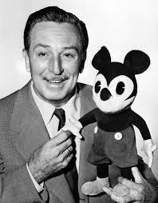
Melding Culture and Strategy
Building a regional approach to meet customer needs
Joint Culture
Training
Compliance
Quality Improvement
Business Intelligence (COMING SOON!)
Building relationships to address opportunities and weaknesses
Care Transitions sales strategy
Managed care pay for performance contract
Notes:
Consistency is key! Would an appropriate clip art be Scrooge McDuck? He’s a Disney character that’s focused on business??

Slide 13





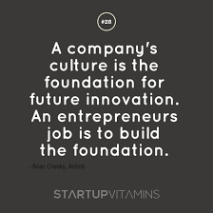
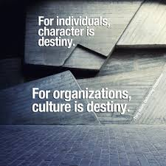
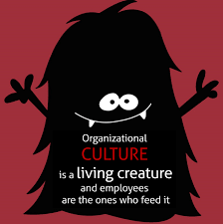
But What is culture?
Notes:
Culture is EVERYTHING!
Culture guides and directs
Shared goals, values, and beliefs
“…the glue that holds an organization together”
Beliefs, behaviors, and attitudes that are consciously lived by
Made of Leaders, Mission, Vision, Values

Slide 14
Culture of Excellence
Addresses Competition in our environment
MyCare Ohio (Duals Demo)
Ohio Home Care (Under 60 Medicaid Waiver)
HOME Choice (MFP)
Front Door (ADRC)
Builds Loyalty by exceeding expectations
By Design
Well Defined
Clear to All
Notes:
Internal first- Hire the right staff, train them, empower them, let them be creative
Standard work- birthday cards, the way we use the phone
Harness subcutures, build on differences to support

Slide 15
Better Together: Common Service Standards
Empowerment
Working within Reality
Think about the future
Provide the tools
Safe Environment
Personal Health and Safety
Adherence to policies and procedures
ID the need
Know your resources
What gets measured gets solved
You are creative, use it!
Share the wealth
Start with solutions
Plan Do Check Act
LEAN starts with me!
LEAN makes experiences better
All staff are LEAN
Save Money, Make Money
Never satisfied
Celebrate your successes
PERSON CENTERED
HEALTH & SAFETY
PROVIDE SOLUTIONS
LEAN
Decision Making Order
Notes:
Akron Canton/Cleveland/Youngstown worked for over a year on creating a formal culture built on commonly accepted service themes and standards. While the theme is a rallying cry, the standards are concrete decision making tools and a guide to all performance and activity in the job.

Slide 16
Joint Training
Two Goals
Standardization of Clinical and Leadership Processes
Reduced cost to AAAs
Three Areas
Clinical Training- Duals Pilot
Continuous Education Credit Trainings
Leadership Development

Slide 17
Compliance Program
Shared Compliance Director—3 AAAs
Auditing and Monitoring plan based on all shared programs
Care Management
Provider Monitoring
Elder Rights/Ombudsman/MFP
Front Door/ADRC
Extensive HIPAA Assessments and action plan
Feeds directly Quality Improvement Program

Slide 18
Quality Improvement Program
Shared program across 3 Northeast Ohio AAAs
Standard program elements
Committee
Performance measures
Quality Improvement Activities
Standard methodology (Lean/Six Sigma)
Evaluation

Slide 19
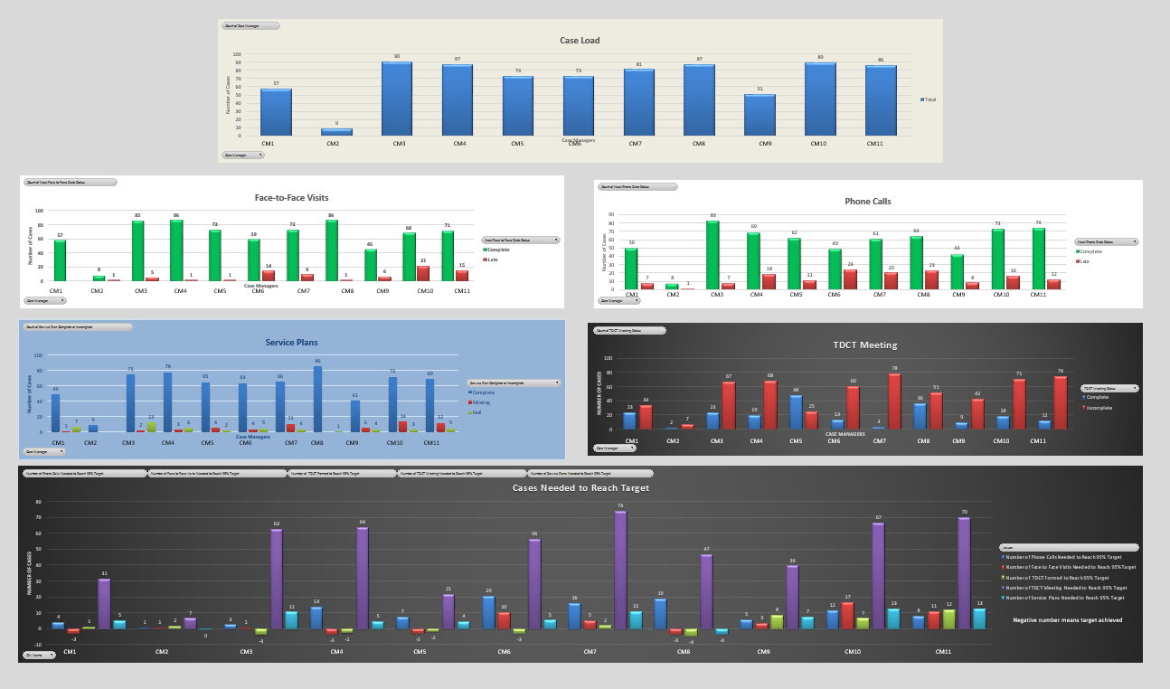
Culture and Quality Improvement—Non-Blaming

Slide 20
Culture and Quality Improvement—Non-Blaming

Slide 21
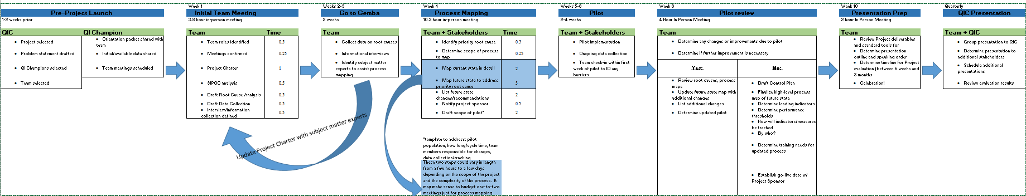
QI Process to address Team Meeting Performance
1.
Project Select.
Team Devlp.
2.
Project Launch
Initial Team Mtg.
3.
Go to Gemba
Root cause ident.
4.
Process Mapping
5.
Pilot
6.
Pilot Review
Control Plan
7.
Present
Training Plan Devlp
8.
Launch

Slide 22
Building Relationships to achieve outcomes
CCTP/Akron Regional Hospital Association
One contact for all partners
Unified competing systems
Pilots with Accountable Care Organization
Show value
Build vs buy
Business Case for Contracts post CCTP
ID Data- Intervention saves $$$ (but no DRG code!)
CJR Bundles
Other Payment Models
Notes:
Current Activity
Build on CCTP
Sell services to those who take on risk
Approach is different than a Medicare Benefit (CCTP Model)

Slide 23
Our future

Slide 24
Remember this List…
Volume to Value, Price & Scale = URGENCY
Need to focus our role(s)—address any conflicts
What happens in Medicare will eventually drive our Medicaid business
The devil is in the details
Data analysis
Contracting (based on Risk & Value)
Relationships
Additional stakeholder engagement needed for local partnerships & to get to scale

Slide 25
Ensuring loyalty
Disney Expo on Customer Experience
Formal process to ID customer experience and enhance service delivery
Link to LEAN Six-Sigma to fully solve for pain points
Leadership Training
12 course certification for current/future leaders
Strong concentration on leading in a culture of excellence

Slide 26
Ensuring quality— Performance-based Activity
Performance based contracts: Combination of activity-based and outcome-based metrics
Timely assessments
Contact and visit schedules
Reducing ED Visits and Readmissions
Nursing Facility Diversion
Compliance Program addressing documentation and consistency
Performance and Compliance Audits drive QI efforts

Slide 27
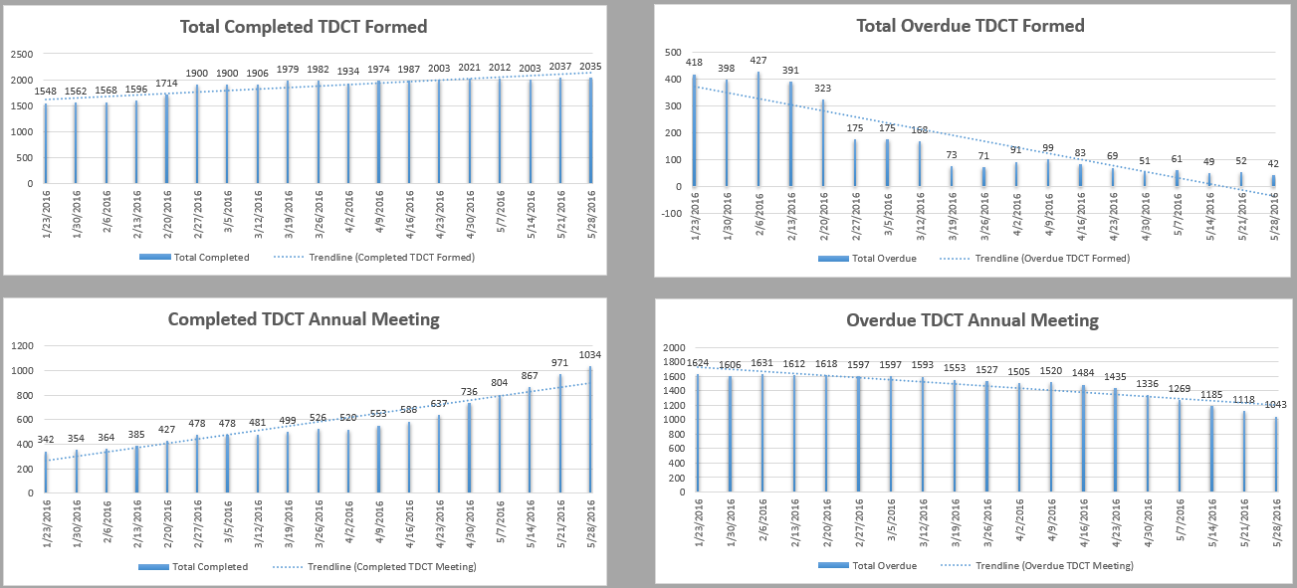
we are getting there

Slide 28
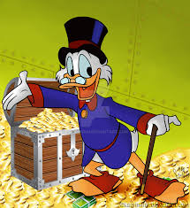
SELL SELL SELL!
Care Transitions
Care Management
Front Door- I and A
Backroom Services

Slide 29
Questions?

