Slide 1
Meet Our Consultants!
USAging Consulting Services
January 13, 2025

Slide 2
The Business Institute
The mission of the Aging and Disability Business Institute (Business Institute) is to successfully build and strengthen partnerships between community-based organizations (CBOs) and the health care system so older adults and people with disabilities will have access to services and supports that will enable them to live with dignity and independence in their homes and communities as long as possible.

Slide 3
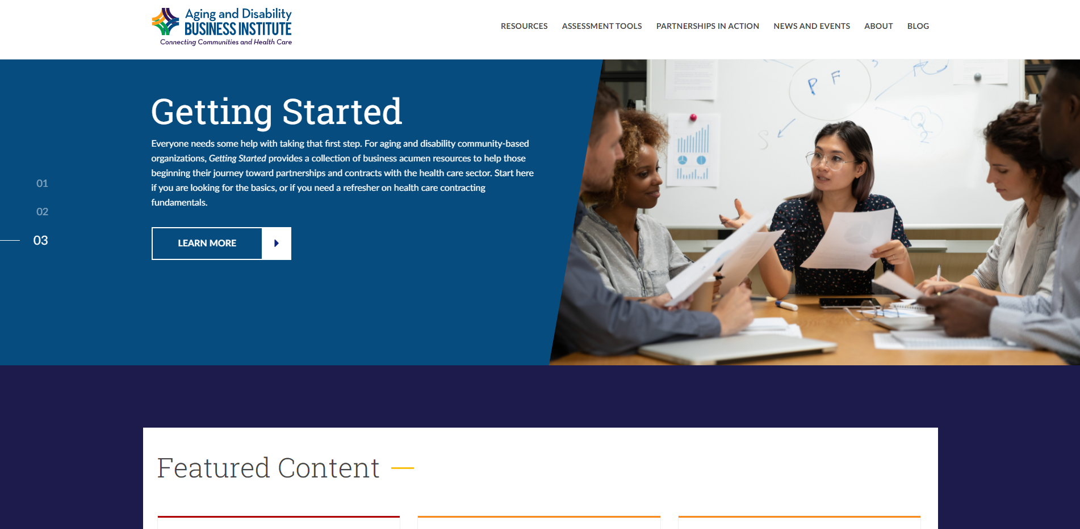
aginganddisabilitybusinessinstitute.org

Slide 4










Business Institute Funders
Business Institute Partners

Slide 5
Our work
Training
Technical Assistance
Resource Development
Information Gathering
Consulting Services
Thought Leadership
Center of Excellence to Align Health and Social Care

Slide 6
Poll Question
What type of organization are you representing today?
Community-based organization
Health care
Government entity
Other

Slide 7
Dr. Michael S. Klinkman
6

Slide 8
Examples of consulting projects
8
1. Comprehensive – Jackson Care Hub
2. Implementation/evaluation – 4AM C2C
3. Cross-sector referrals – west MI IR pilot

Slide 9
Jackson Care Hub (2015-2019)
9
State | Michigan, Jackson County
CBOs | United Way, 211, Community Action Agency, AAA, CMH [and 30+ CBOs]
Client | Community partnership: Health system, community network, Health Department created a local network lead entity to support medical-social care integration
Scope | COMPREHENSIVE: create sustainable community care hub to support connections between medical, mental health, and social care. *very similar to USAging COE CCH project*
Expertise | Overall project leadership: Visioning, strategic planning, community co-design assistance and facilitation, technical support, IT infrastructure design and implementation
Impact/outcome: | Successful co-design and implementation Created role of local 211 Navigator [to supplement local care navigator cohort] Successful and scalable IT infrastructure [now funded through local health system] Sustainable community care hub Local governance still in evolution

Slide 10



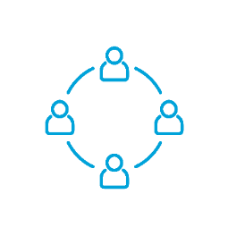

10
Two stages of community co-design work
SDoH
screening, assessment and referral
B.H. + S.A. screening, assessment and reimbursement
Community
hub to share
critical information
Telehealth
and video on demand platform (in development)
1. Community co-design of system of care
Understanding the community space
Actively engaging the community in participatory design
2. Building community infrastructure
Extending care coordination across sectors
Implementing technical infrastructure

Slide 11
Community co-design process [30+ months]
11
Pre-work: action research
  Semi-structured interviews of lay community, stakeholders, providers, leaders
Creation of working group structure
  Collective Impact model extended to new participants, groups
  Health Improvement Organization Coordinating Committee as lead
Clinical-Community Linkages group as ‘steering committee’
  Several volunteer ad-hoc groups emerged (care model, navigation, Data/IT)
  Convening community service agencies
  Co-design of care model, infrastructure, and core IT application(s) requirements
Large-scale conversations across domains
Governance, stewardship, sustainability
  Development of shared action plan

Slide 12
Current status of Jackson Care Hub
12
In routine use, 40+ CBOs actively engaged
Local governance by committee, sponsored by local health system
Expanding capacity (example: utility assistance screening and support)
IT vendor participating in MI cross-sector data exchange pilots
Cumulative statistics since 7/2018 launch:
  Over 750,000 SDOH screens (majority of population with multiple screens)
  Over 40,000 social care referrals entered and tracked
  Most common SDOH needs – literacy(!), transportation, food and utility assistance
Online: https://jacksoncarehub.org/

Slide 13
Connected2Care (2017-2020)
13
State | Michigan, northern MI [extending to engage full Michigan AAA network]
CBOs | AAA Association of Michigan, Region 10 (NW MI) AAA and community partners [+ Northern MI Physician Organization, MiHIN]
Client | AAA Association of Michigan
Scope | To improve care coordination by integrating electronic health notifications (ADT messages) into the IT system used across AAA service delivery system, and to develop best practices for incorporating notifications into care coordination workflow
Expertise | Project planning, clinical workflow design, technical assistance on use of data exchange protocols (MiHIN), overall evaluation
Impact/outcome: | Successful implementation of ADT message intake and client matching Improved care coordination workflow Improved care coordination outcomes (readmission(?), disconnected handoffs) Uncovered internal resource limitations Uncovered data exchange issues (data quality, patient matching, slow process, vendor limitations)

Slide 14
14
“I have known Dr. Klinkman for many years and have worked with him on a variety of projects in different organizations. Dr. Klinkman is a truly unique and brilliant individual. Through his persona, experience, knowledge and passion, he brings together a calling to improve community conditions for all, the knowledge and perspective of a physician and the healthcare industry, an understanding of the social care/CBOs systems, and a vision for improved health and well-being using data and interoperability for coordination of disparate care systems and person-centered care-planning with individuals. He is strategic, analytical, technical and compassionate. Dr. Klinkman has significant experience in mobilizing, facilitating, (and instigating) diverse groups to think through new lenses to find shared commonalities and opportunities.”
Heidi Gustine
CEO Area Agency on Aging of Northwest Michigan

Slide 15
West Michigan Interoperable Referrals Pilot
(2024-Present )
15
State | Michigan [one of several cross-sector data exchange pilots]
CBOs | Senior Resources of West MI, Access Health, 211, [+Trinity Health of West MI, MiHIN]
Client | MiHIN [+ MDHHS]
Scope | To test feasibility, utility, value of a standard electronic Interoperable Referral message to formally document referral between a medical care organization and a CBO and update status of that referral. This pilot tests interoperability / data exchange across each organization’s IT system of record. The IR message is intended to serve as the key building block for documenting contracts between health and social care.
Expertise | IR message design, clinical workflow design, technical assistance on use of MiHIN data exchange protocols
Impact/outcome (to date – project launch expected Q1 2025) : | Successful engagement of cross-sector partners (CBOs, systems, IT vendors) Vendor interoperability pledge in place IR message content created Synthetic data exchange environment prepared Many operational challenges (timing, priority, vendor readiness……)

Slide 16

16
Corewell Health
Trinity Health
Michigan Medicine West
Cherry Street [FQHC]
Area Agency on Aging of West MI
Heart of West MI UW/2-1-1
Hope Network
Grace Network
HealthNet
of West Michigan
Kent County Health Department
Activities to date:
MHEF planning grant 6/19-6/20, REBOOT 11/24
New health system leadership in place, more supportive
Steering committee deliberations
Inventory - multiple IT platforms, not yet interoperable
Community stakeholder re-engagement focused on pilot project(s)

Slide 17
17
“Many seek out thought-leaders to inform and drive change. Dr. Klinkman takes thought-leadership to the next level. He leads with a dual passion of thought-leadership AND action-leadership and in doing so profoundly role models and drives goodness.”
“Often when bringing many voices to the table to seek improvement, inherent individual and individual organizational goals can seem to outweigh collaborative goals. Dr. Klinkman understands this phenomenon, and through his humble heart and his ability to engage and maintain a keen focus on the bigger picture (the collaborative goal) he positions others to do so too for the greater good.”
Susan J. Vos BSN, RN, CCM Tom Dahlborg
MI-CCSI Program Director MI-CCSI Executive Director

Slide 18
18
Methods toolbox, lessons learned……

Slide 19
19
Methods toolbox – community codesign work
Collective Impact model --------- process followed for all Jackson community work
Environmental scan/system scan ------- conducted in early exploratory phase
ABLe change framework -------- model of change to guide community transformation
Ethnography (‘field notes’) ------- enhance understanding of community process and meta-issues
Action research ------- small projects with rapid review and feed-forward
Boundary Objects ----------- documents or pictures used to bring together diverse communities
‘Personas’ --------- use of case examples to frame cross-disciplinary conversation (“Millie Jones” )
‘Living labs’ -------- multi-stakeholder sessions to explore cross-jurisdictional problems and solutions
Participatory design ------- ‘chunked’ longitudinal community co-design exercises
Practice detailing (facilitation) ---------- implementation assistance for medical practices
Outcomes assessment -------- determining core community metrics and measurement approach
Learning collaboratives ------- regional and statewide sharing and dissemination

Slide 20

Some critical points along path
20
Community shared visioning (convening)
“All Aboard!” (who’s in? who’s out?)
  at this point, is there an emergent community?
Bringing in medical care delivery system(s)
  as partners, not as controllers
Bringing in IT suppliers and vendors
  to support co-designed care model and workflow
Developing governance structure and ownership

Slide 21
Lessons learned in community codesign work
21
We need to STUDY THIS PROCESS IN MORE DEPTH
This is a fragile process –
  Differences in motivations, incentives, goals among partners (medical and CBO)
  Differences in care model between medical and community organizations
  Significant power differential
ASSEMBLAGES, not partnerships, are the rule
How do differences get worked out?
  Initiative tends to be with medical enterprise
  Solutions can take one of 3 forms (Enterprise, Hub and Spoke, Community Hub) but power differential can greatly influence this
Addressing power differential is critical

Slide 22
Jackson Care Hub IT infrastructure build
22
‘medical enterprise’
EHR
Community
SS Navigation
application
Phase 1:
Support SDoH screening, assessment and referral across community
using 2-1-1 database
Phase 1a:
Limited data exchange with Epic to allow bidirectional exchange of SDoH and referral data;
Single signon in Epic
Federation Hub
Other Hubs
Other community “spoke” systems (end points)
Phase 2:
Connect community IT platforms to Hub to simplify CBO workflow

Slide 23

23
Community sectors engaged in codesign
Hospitals
Health systems
Medical practices
Payors/insurers
Behavioral health
Community Mental Health
Health & Social Services
Community based organizations
Churches, charities
Less formal help networks
Neighborhood groups
Educational system
Legal-correctional systems
Local government(s)
Public health
Community ‘attractors’
Lay community members

Slide 24

Power
Medical care space
24
PCMH
Hospitals
Health systems
Public Health
CMH
CHC/
PCMH
Schools
Large CBOs
Behavioral health
Substance use
Community service brokers- United Way/2-1-1, HealthNet, DHHS
Community ‘attractors’
Small CBOs
Neighborhoods
Community members
Informal care providers
Scale
Figure: Representational view of organizations involved in providing medical and social care
[ovals indicate informal, less-organized groups or providers; plain text indicates brokers]

Slide 25
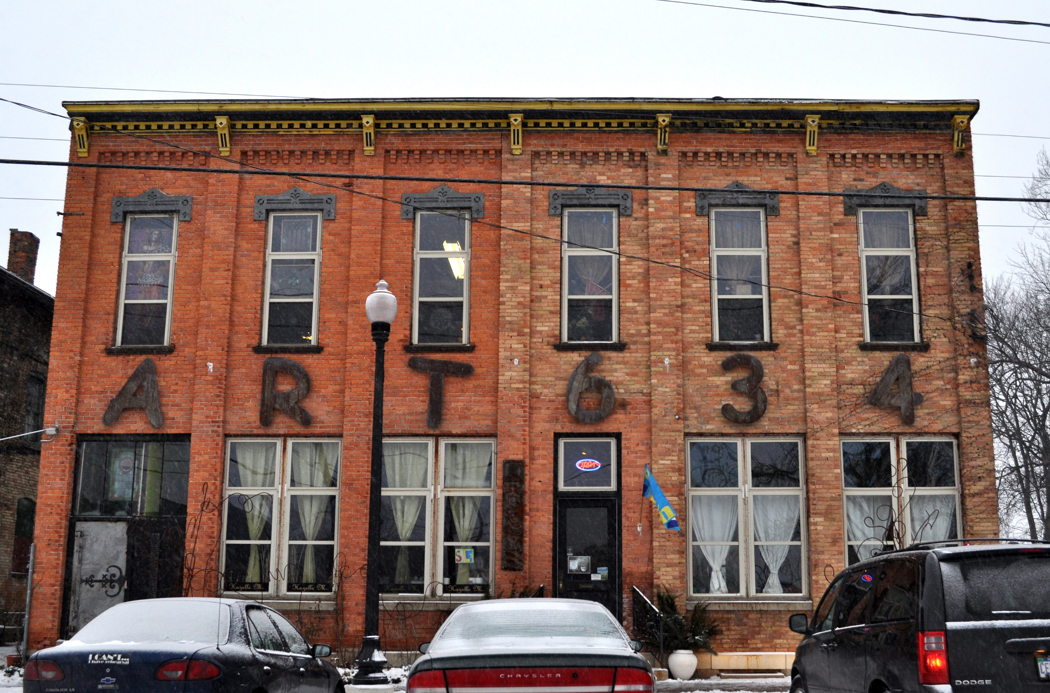
25
Participatory design tasks completed by community ad hoc groups 2016-2018
Deciding on approach and scope of work
Identifying a vendor partner
Co-designing a community care model – to establish common steps in the care process for all service providers
Developing a community-wide Social Determinants of Health (SDoH) screening tool - and common approach to screening
Co-developing (with IT vendor) key functional requirements
Launching the Hub – testing functionality, prototyping, and implementing

Slide 26

Questions/Comments?
Notes:
PAUL READ QUESTIONS ALOUD FOR LORI FROM Q&A BOX

Slide 27
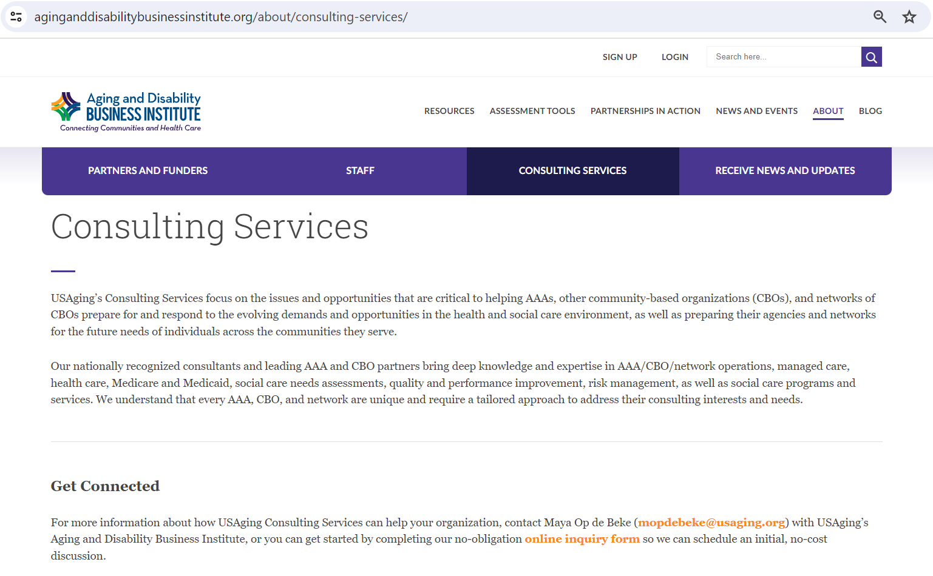
https://www.aginganddisabilitybusinessinstitute.org/about/consulting-services/
Notes:
This page is also where you can review previous recordings featuring our consultants.

Slide 28
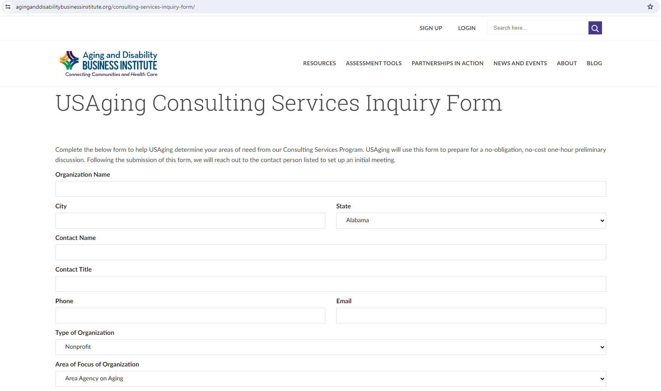
Get Connected to Consulting Services Today!
https://www.aginganddisabilitybusinessinstitute.org/consulting-services-inquiry-form/
1-hour free exploratory call
Notes:
How to get connected to us, use online inquiry form

Slide 29
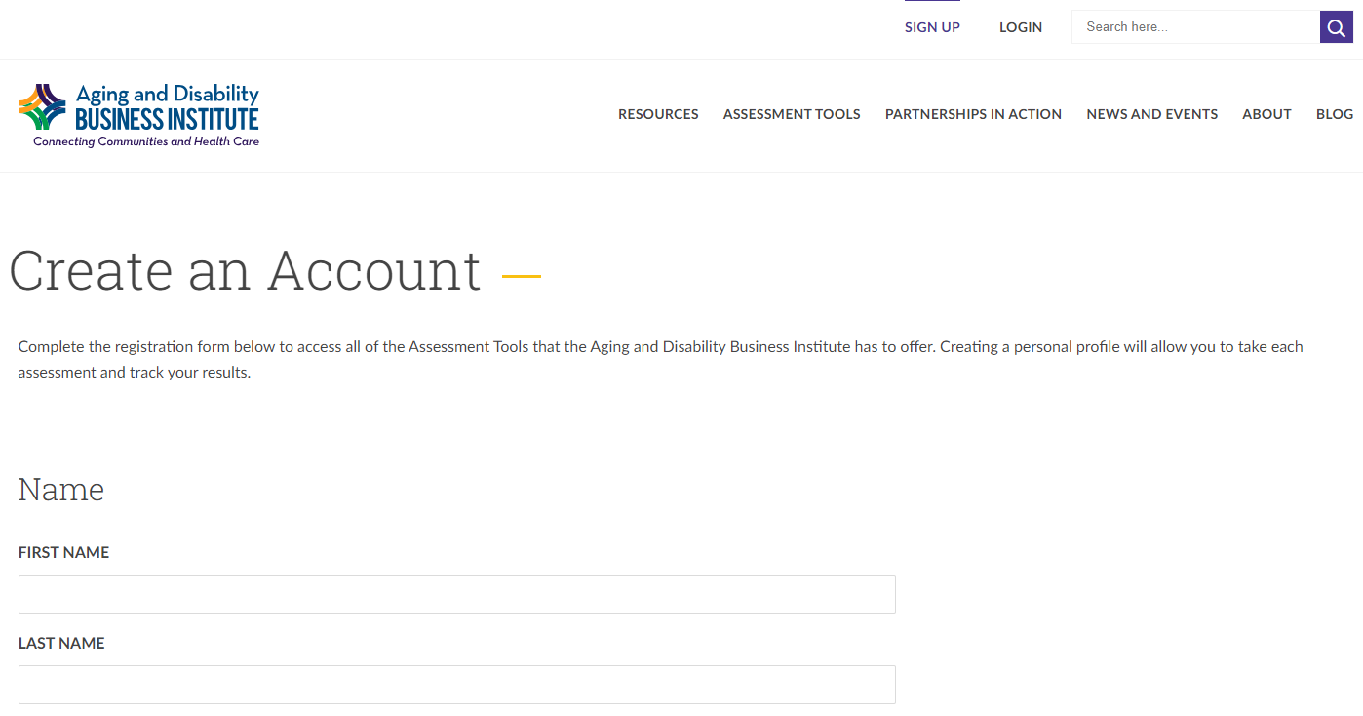
Stay informed about our resources!

Slide 30
Connect with Us
Visit our website to learn more about the Business Institute: aginganddisabilitybusinessinstitute.org
Learn about our Center of Excellence to Align Health and Social Care: https://coe.aginganddisabilitybusinessinstitute.org/
Learn more about our Consulting Services: https://www.aginganddisabilitybusinessinstitute.org/about/consulting-services/
Still have questions? Email us:
BusinessInstitute@usaging.org
Stay connected, sign up for our newsletter:
https://www.aginganddisabilitybusinessinstitute.org/subscribe-to-our-mailing-list/
Notes:
Other ways to stay connected to ADBI

Slide 31
Next Featured Consultant Webinar:
Tuesday February 18, 2025, 2pm ET!

